Slide 1
NMC 16S 35Ah Pack
Battery pack performance report

Slide 2
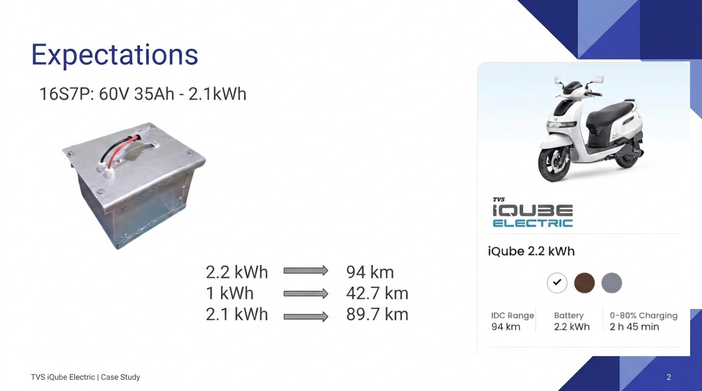


Slide 3
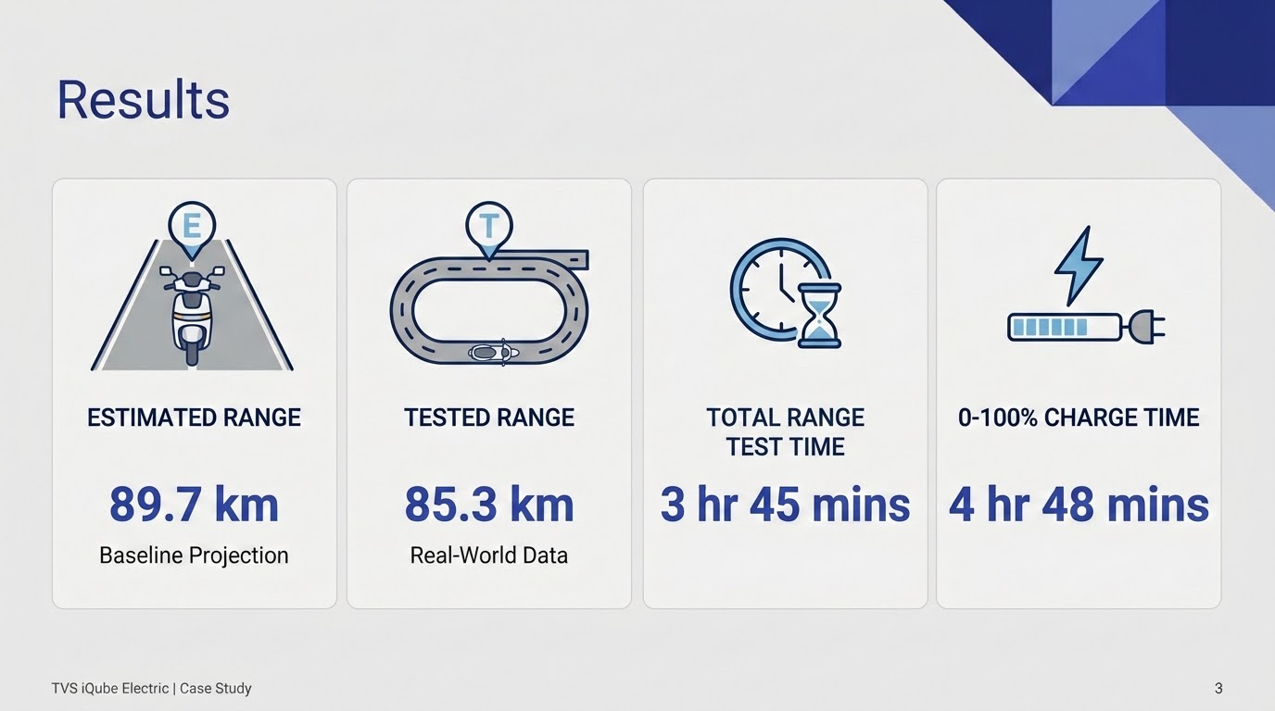

Slide 4
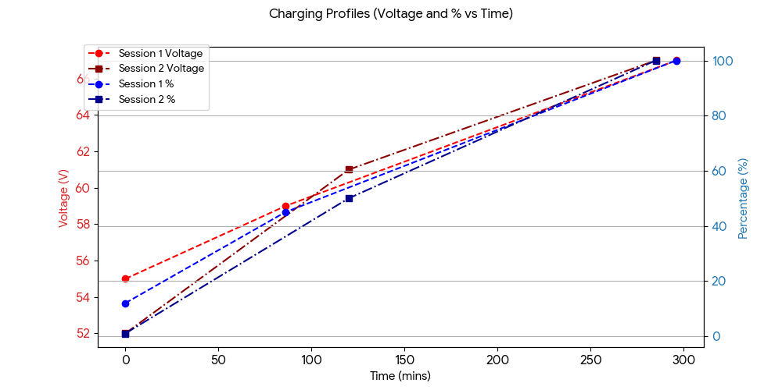

Slide 5
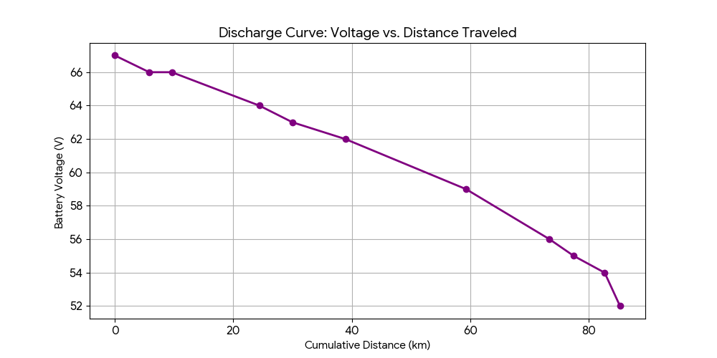

Slide 6
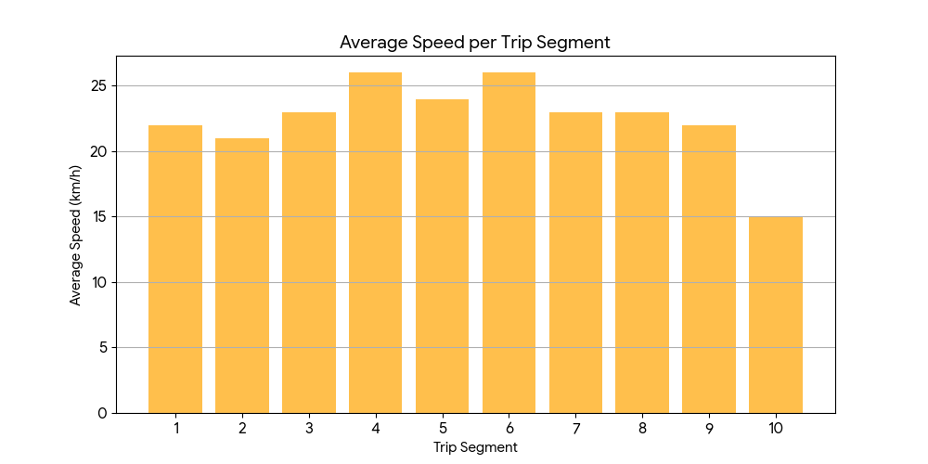

Slide 7
Tiranga GEM review
Inaccurate speedometer & odometer
Soft suspension = bumpy ride
No partial braking = less control
Cruise control activates too early
Seat tears itself by grab handle
Uncomfortable for long legs

Slide 8
Thank You
max growth

